Slide 1
Classical Encryption Techniques
This lecture slide is mainly based on the power point slides by Professor Lawrie Brown.
Notes:
Zili Shao

Slide 2
Basic Methods of Symmetric Encryption
1. Substitution:
Noclasstoday→ opdmbttupebz
2. Transposition: rearrange the sequence of the plaintext
Noclasstoday→ ncossaolstdy
3. Product: Multiple stages of Substitution and Transposition
CEG 260, Meilin Liu
Notes:
Zili Shao

Slide 3
Classical Cryptosystems
Shift Cipher:
Letters of the alphabet are assigned a number as below
A 0 | B 1 | C 2 | D 3 | E 4 | F 5 | G 6 | H 7 | I 8 | J 9 | K 10 | L 11 | M 12
N 13 | O 14 | P 15 | Q 16 | R 17 | S 18 | T 19 | U 20 | V 21 | W 22 | X 23 | Y 24 | Z 25
Example: No class today→ op dmbtt upebz
Algorithm:
Encryption: E_{k}(x) = (x + k) mod 26.
Decryption: D_{k}(x) = (x – k) mod 26.
CEG 260, Meilin Liu
Notes:
Zili Shao

Slide 4
Classical Cryptosystems – Shift Cipher
Remark: When k = 3 the shift cipher is given a special name -
Caesar Cipher (by Julius Caesar).
example:
  meet me after the toga party
  PHHW PH DIWHU WKH WRJD SDUWB
Convention: plaintext by small letter; but ciphertext by CAPITAL LETTER.
CEG 260, Meilin Liu
Notes:
Zili Shao

Slide 5
Classical Cryptosystems – Shift Cipher
Example: Let the key k = 17
Plaintext: X = A T T A C K = (0, 19, 19, 0, 2, 10).
Ciphertext : Y = (0+17 mod 26, 19+17 mod 26, …)
Y = (17, 10, 10, 17, 19, 1) = R K K R T B
Attacks on Shift Cipher
Exhaustive Search: Try all possible keys. |K|=26.
Nowadays, for moderate security |K| ≥ 2⁸⁰ ,
for recommended security |K| ≥ 2¹⁰⁰ .
Letter frequency analysis (Same plaintext maps to same ciphertext
CEG 260, Meilin Liu
Notes:
Zili Shao

Slide 6
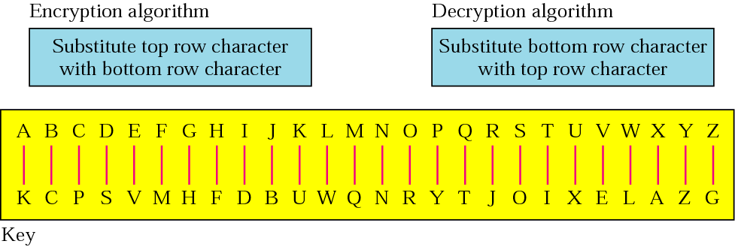
Monoalphabetic Cipher
Map the letter to an arbitrary letter.
CEG 260, Meilin Liu
Notes:
Zili Shao

Slide 7
Monoalphabetic Cipher Security
Key space: 26!
Is it secure? It is still not secure
The problem is language characteristics: letters are not equally commonly used.
In English E is by far the most common letter, then T,R,N,I,O,A,S
Other letters are fairly rare, such as, Z,J,K,Q,X
CEG 260, Meilin Liu
Notes:
Zili Shao

Slide 8

English Letter Frequencies
CEG 260, Meilin Liu
Notes:
Zili Shao
This graph is based on counts done at ADFA in the late 1980's, and used to develop the tables published in Seberry & Pieprzyk [SEBE89].
Note that all human languages have varying letter frequencies, though the number of letters and their frequencies varies.
Seberry & Pieprzyk [SEBE89] Appendix A has graphs for 20 languages (most European & Japanese & Malay).

Slide 9
Use in Cryptanalysis
Key concept - monoalphabetic substitution ciphers do not change relative letter frequencies
Calculate letter frequencies of ciphertext
Compare counts/plots against known values
if Caesar cipher look for common peaks/troughs
  peaks at: A-E-I triple, NO pair, RST triple
For monoalphabetic must identify each letter
  tables of common double/triple letters help
CEG 260, Meilin Liu
Notes:
Zili Shao
The simplicity and strength of the monoalphabetic substitution cipher meant it dominated cryptographic use for the first millenium AD. It was broken by Arabic scientists. The earliest known description is in Abu al-Kindi's "A Manuscript on Deciphering Cryptographic Messages", published in the 9th century but only rediscovered in 1987 in Istanbul, but other later works also attest to their knowledge of the field.

Slide 10
Example Cryptanalysis
Given ciphertext:
  UZQSOVUOHXMOPVGPOZPEVSGZWSZOPFPESXUDBMETSXAIZ
  VUEPHZHMDZSHZOWSFPAPPDTSVPQUZWYMXUZUHSX
  EPYEPOPDZSZUFPOMBZWPFUPZHMDJUDTMOHMQ
Count relative letter frequencies
Guess P & Z are e and t
Guess ZW is th and hence ZWP is the
Proceeding with trial and error finally get:
  it was disclosed yesterday that several informal but
  direct contacts have been made with political
  representatives of the viet cong in moscow
CEG 260, Meilin Liu
Notes:
Zili Shao

Slide 11
Block Ciphers
In the substitution ciphers, changing one letter in the plaintext changes exactly one letter in the ciphertext.
This greatly facilitates finding the key using frequency analysis.
Block ciphers prevents this by encrypting a block of letters
simultaneously.
Many of the modern (symmetric) cryptosystems are
block ciphers. DES operates on 64 bits of blocks while AES uses 128 bits of blocks.
Example:Playfair Cipher; Hill Cipher
The key is an n × n matrix whose entries are integers in Ζ₂₆.
CEG 260, Meilin Liu
Notes:
Zili Shao

Slide 12
Playfair Cipher
The large number of keys in a monoalphabetic cipher does not provide enough security
One approach to improving security was to encrypt multiple letters
Playfair Cipher: invented by Charles Wheatstone in 1854, but named after his friend Baron Playfair
Used in World War I by British and in World War II by USA
CEG 260, Meilin Liu
Notes:
Zili Shao
Consider ways to reduce the "spikyness" of natural language text, since if just map one letter always to another, the frequency distribution is just shuffled. One approach is to encrypt more than one letter at once. Playfair cipher is an example of doing this.

Slide 13
Playfair Key Matrix
5X5 matrix of letters constructed using a keyword
Fill in 5*5 Matrix with the letters of keyword (minus duplicates), then fill the rest of matrix with other letters from left to right, and from top to the bottom (I/J is treated as one letter).
eg. using the keyword MONARCHY
    M O N A R
    C H Y B D
    E F G I K
    L P Q S T
    U V W X Z
CEG 260, Meilin Liu
Notes:
Zili Shao
Have here the rules for filling in the 5x5 matrix, L to R, top to bottom, first with keyword after duplicate letters have been removed, and then with the remain letters, with I/J used as a single letter. This example comes from Dorothy Sayer's book "Have His Carcase", in which Lord Peter Wimsey solves this, and describes the use of a probably word attack.

Slide 14
Encrypting and Decrypting
Encrypt the plaintext two letters at a time:
  if a pair is a repeated letter, insert a filler like ‘x', eg. "balloon" encrypts as "ba lx lo on"
  if both letters fall in the same row, replace each with letter to right (wrapping back to start from end), eg. “ar" encrypts as "RM"
  if both letters fall in the same column, replace each with the letter below it (again wrapping to top from bottom), eg. “mu" encrypts to "CM"
  otherwise each letter is replaced by the one in its row and the column of the other letter of the pair, eg. “hs" encrypts to "BP", and “ea" to "IM" or "JM" (as desired)
CEG 260, Meilin Liu
Notes:
Zili Shao
Note the various rules, and how you wrap from right side back to left, or from bottom back to top. Decrypting of course works exactly in reverse. Can see this by working the example pairs shown, backwards.

Slide 15
Security of the Playfair Cipher
Security much improved over monoalphabetic
Since have 26 x 26 = 676 digrams, you would need a 676 entry frequency table to analyse (verses 26 for a monoalphabetic) and correspondingly more ciphertext
It can be broken, given a few hundred letters
since still has much of plaintext structure
CEG 260, Meilin Liu
Notes:
Zili Shao

Slide 16
Hill cipher -- introduction
Another polyalphabetic cipher.
Invented in 1929 by Lester S. Hill.
Let m be an positive integer, and let P = C (Z₂₆)^{m}
First divide the characters in plaintext into blocks of m characters, take m linear combinations of the m characters, thus producing the m characters in ciphertext.
C=E(K,P)=K*P mod 26
P=D(K,C)=K^(-1)*C mod 26 =K^(-1)*K*P mod 26 = P
CEG 260, Meilin Liu
Notes:
Zili Shao

Slide 17
Hill cipher -- introduction
Another polyalphabetic cipher.
Invented in 1929 by Lester S. Hill.
Let m be an positive integer, and let P = C (Z₂₆)^{m}
Use an m x m matrix K as the key. Encrypt by breaking plaintext into blocks of length m (padding with x’s if needed) and multiplying each by K (mod 26).
C=E(K,P)=K*P mod 26
P=D(K,C)=K^(-1)*C mod 26 =K^(-1)*K*P mod 26 = P
CEG 260, Meilin Liu
Notes:
Zili Shao

Slide 18



Hill cipher -- example
Suppose m=2, a plaintext element is written as x= and
a ciphertext element as y= .
Here y₁ would be a linear combination of x₁ and x₂, as would y₂.
Suppose we take:
y₁=(5x₁ + 8x₂) mod 26
y₂=(17x₁ + 3x₂) mod 26
then y₁ and y₂ can be computed from x₁ and x₂
We can write the above computations in matrix notation:
or y = Kx where y= , x= , and K=( )
5 8
17 3
Assume all operations are performed by modulo 26.
CEG 260, Meilin Liu
Notes:
Zili Shao

Slide 19
“Mod” operator – modulo
In integer arithmetic, if we divide x by y, we can get q and r. The relationship between these four integers can be shown as
x/y = q + r/ y, i.e., x= q*y+r
Here, we call x the dividend; y, the divisor; q, the quotient; and r, the remainder.
r = x mod y → x = x- int(x/y)*y,
i.e., the remainder of x/y
Examples:
  5 mod 9 = 5 – 0*9 = 5
  9 mod 9 = 0
  10 mod 9 = 1
  20 mod 9 = 2
CS400/600, Meilin Liu
Notes:
Zili Shao

Slide 20

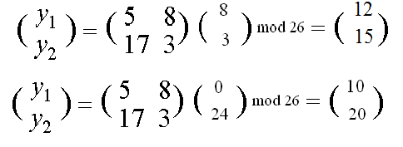
Hill cipher – example
Example, suppose key is:
K=( )
A 0 | B 1 | C 2 | D 3 | E 4 | F 5 | G 6 | H 7 | I 8 | J 9 | K 10 | L 11 | M 12
N 13 | O 14 | P 15 | Q 16 | R 17 | S 18 | T 19 | U 20 | V 21 | W 22 | X 23 | Y 24 | Z 25
5 8
17 3
C=K*P
Given plaintext: friday, the ciphertext is: FGMPKU
CEG 260, Meilin Liu
Notes:
Zili Shao

Slide 21

Hill cipher – example
On the other hand, from PQCFKU, we can get friday.
How to decrypt?
C=K*P →
K⁻¹*C=P
K⁻¹*K=I
K=( )
K⁻¹=( )
5 8
9 2
1 15
17 3
then
K⁻¹*K=I
CEG 260, Meilin Liu
Notes:
Zili Shao

Slide 22

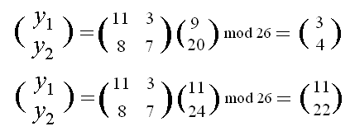
Hill cipher – example
Example, suppose key is:
C=K*P
Given plaintext: july, the ciphertext is: DELW
CEG 260, Meilin Liu
Notes:
Zili Shao

Slide 23

Hill cipher – example
On the other hand, from PQCFKU, we can get friday.
How to decrypt?
C=K*P →
K⁻¹*C=P
K⁻¹*K=I
K=( )
K⁻¹=( )
11 3
7 23
18 11
8 7
then
K⁻¹*K=I
CEG 260, Meilin Liu
Notes:
Zili Shao

Slide 24
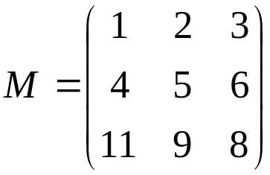
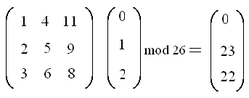
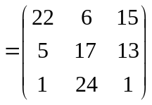

Hill Cipher -- example
Example: Let n=3 and the key matrix be
and the plaintext be ABC = (0, 1, 2) then the encryption
operation is a matrix-vector multiplication
In order to decrypt we need the inverse of key matrix M, which is
CEG 260, Meilin Liu
Notes:
Zili Shao

Slide 25
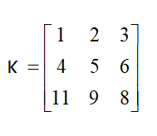
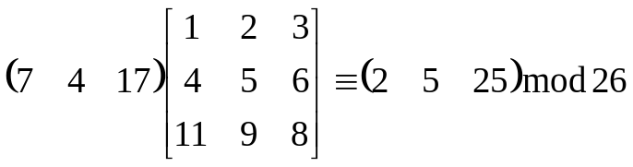
Hill Ciphers – Different Notation
Example: Encrypt “hereissomeonetoencrypt” using K
her eis som eon eto enc ryp txx
(7, 4, 17) (4, 8, 18) … (19, 23, 23)
C=P *K =
(2, 5, 25) (0, 2, 22) … (0, 22, 15)
cfz acw yga vns ave anc sdd awp
“CFZACWYGAVNSAVEANCSDDAWP”

Slide 26
Hill cipher – algebra foundation
Determinant of a matrix A, denoted by det A :
  -- if A(a_{ij}) is 2×2, then det A =a₁₁a₂₂ – a₁₂a₂₁
  -- if A(a_{ij}) is 3×3, then det A =a₁₁a₂₂a₃₃ + a₁₂a₂₃a₃₁ + a₁₃a₂₁a₃₂
  - a₁₃a₂₂a₃₁ - a₁₂a₂₁a₃₃ - a₁₁a₂₃a₃₂
k₁₁ k₁₂
k₂₁ k₂₂
with k_{ij} ∈ Z₂₆
2. Theorem: suppose
K=( )
Then K has an inverse if and only if det K is invertible in Z₂₆
if and only if gcd(det K, 26)=1
CEG 260, Meilin Liu
Notes:
Zili Shao

Slide 27
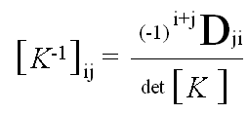

Hill cipher – algebra foundation
k₁₁ k₁₂
k₂₁ k₂₂
with k_{ij} ∈ Z₂₆
2. Theorem: suppose
K=( )
Then K has an inverse if and only if det K is invertible in Z₂₆
if and only if gcd(det K, 26)=1
Moreover,
k₂₂ -k₁₂
-k₂₁ k₁₁
K⁻¹=(det K)⁻¹( )
Where det K = k₁₁k₂₂ – k₁₂k₂₁
In other words,
is the determinate of the sub-matrix by deleting row j
and column i of matrix k
CEG 260, Meilin Liu
Notes:
Zili Shao

Slide 28
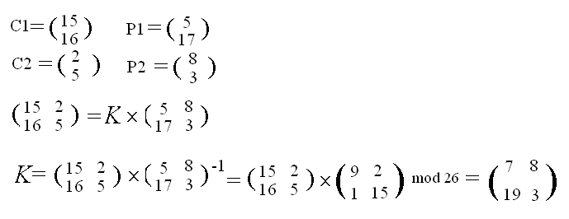
Block Ciphers – Hill Cipher
Strong for cipher only attack
Very easy for know-plaintext attack, i.e., some pairs of plaintext, ciphertext (P,C)
(C1,P1),…(Cm,Pm)
Cj=K*Pj
(C1 C2 …Cm)=K* (P1 P2 …Pm)
C*P^(-1)=K*P*P^(-1)=K
e.g., m=2
CEG 260, Meilin Liu
Notes:
Zili Shao

Slide 29
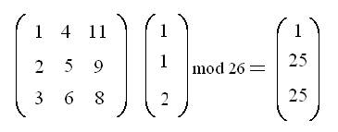
Block Ciphers – Hill Cipher
If we change one letter in the plaintext, all the letters of the
ciphertext will be affected.
Let the plaintext be BBC instead of ABC then the ciphertext
Let the plaintext be BBC instead of ABC then the ciphertext will be BZZ.
Claude Shannon, in Communication theory of secrecy systems
Bell Systems Technical Journal 28, (1949), 656-715,
introduced properties that a good cryptosystems should have:
Diffusion: one character change in the plaintext should
effect as many ciphertext characters as possible, and v.v.
Confusion: The key should not relate to the ciphertext
in a simple way.
CEG 260, Meilin Liu
Notes:
Zili Shao

Slide 30
Polyalphabetic Ciphers
In monoalphabetic substitution, the relationship between a character in the plaintext to the character in the ciphertext is always one-to-one.
If the same character at different locations in plaintext is mapped into different characters in ciphertext, called polyalphabetic cryptosystems. It makes cryptanalysis harder with more alphabets to guess and flatter frequency distribution.
Vigenere cipher is a kind of polyalphabetic cipher:
  Each key consists of m characters, called keyword.
  Encrypt m characters at a time, i.e., each plaintext element is equivalent to m characters.
  Devised by Blaise de Vigenere in the sixteen century.
CEG 260, Meilin Liu
Notes:
Zili Shao
One approach to reducing the "spikyness" of natural language text is used the Playfair cipher which encrypts more than one letter at once. We now consider the other alternative, using multiple cipher alphabets in turn. This gives the attacker more work, since many alphabets need to be guessed, and because the frequency distribution is more complex, since the same plaintext letter could be replaced by several ciphertext letters, depending on which alphabet is used.

Slide 31
Vigenere cipher—formal definition
Let m be an positive integer.
  Define P = C = K,= Z₂₆.
  For each K= (k₁,k₂,…,k_{m}), define
e_{K}(x₁,x₂,…,x_{m}) = (x₁+ k₁, x₂+ k₂,…, x_{m}+ k_{m})
and
d_{K}(y₁,y₂,…,y_{m}) = (y₁- k₁, y₂- k₂,…, y_{m}- k_{m})
Where all operations are performed in Z_{26,} i.e, mod 26..
CEG 260, Meilin Liu
Notes:
Zili Shao

Slide 32
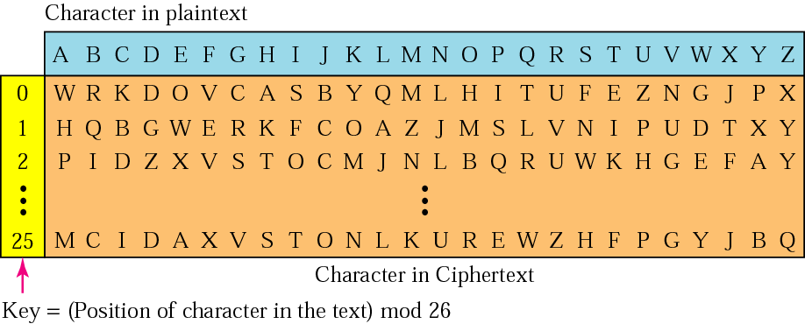
Vigenère Cipher
CEG 260, Meilin Liu
Notes:
Zili Shao
Simply create a set of caesar cipher translation alphabets, then use each in turn, as shown next.

Slide 33
Vigenere cipher—example
A 0 | B 1 | C 2 | D 3 | E 4 | F 5 | G 6 | H 7 | I 8 | J 9 | K 10 | L 11 | M 12
N 13 | O 14 | P 15 | Q 16 | R 17 | S 18 | T 19 | U 20 | V 21 | W 22 | X 23 | Y 24 | Z 25
Using keyword deceptive
  key: deceptivedeceptivedeceptive
  plaintext: wearediscoveredsaveyourself
  ciphertext:ZICVTWQNGRZGVTWAVZHCQYGLMGJ
Using keyword = CIPHER
Given plaintext:
  thiscryptosystemisnotsecure
The ciphertext will be
  VPXZGIAXIVWPUBTTMJPWIZITWZT
On the contrary, subtract the keyword from ciphertext to get the plaintext.
CEG 260, Meilin Liu
Notes:
Zili Shao

Slide 34
Vigenere cipher—security
Question: what is the key space? Suppose the keyword length is m.
There are total 26^{m} possible keys.
Suppose m=5, then 26⁵ = 1.1 × 10⁷ , which is large enough to
preclude exhaustive key search by hand.
However, we will see that there will be a systemic method to
break Vigenere cipher.
CEG 260, Meilin Liu
Notes:
Zili Shao

Slide 35
Security of Vigenère Ciphers
In monoalphabetic substitution, the relationship between a character in the plaintext to the character in the ciphertext is always one-to-one.
In polyalphabetic substitution, the relationship between a character in the plaintext and a character in the ciphertext is one-to-many.
Have multiple ciphertext letters for each plaintext letter
hence letter frequencies are obscured, but not totally lost
start with letter frequencies
  see if look monoalphabetic or not
if not, then need to determine number of alphabets, since then can attack each
CEG 260, Meilin Liu
Notes:
Zili Shao

Slide 36
Autokey Cipher
Ideally want a key as long as the message
Vigenère proposed the autokey cipher
Keyword is prefixed to message as key
Knowing keyword can recover the first few letters; use these in turn on the rest of the message; but still have frequency characteristics to attack
eg. given key deceptive
  key: deceptivewearediscoveredsav
  plaintext: wearediscoveredsaveyourself
  ciphertext:ZICVTWQNGKZEIIGASXSTSLVVWLA
CEG 260, Meilin Liu
Notes:
Zili Shao
See that the key used is the keyword "DECEPTIVE" prefixed to as much of the message "WEAREDISCOVEREDSAV" as is needed. When deciphering, recover the first 9 letters using the keyword "DECEPTIVE". Then instead of repeating the keyword, start using the recovered letters from the message "WEAREDISC". As recover more letters, have more of key to recover later letters.
Problem is that the same language characteristics are used by the key as the message. ie. a key of 'E' will be used more often than a 'T' etc
hence an 'E' encrypted with a key of 'E' occurs with probability (0.1275)2 = 0.01663, about twice as often as a 'T' encrypted with a key of 'T'
have to use a larger frequency table, but it exists given sufficient ciphertext this can be broken.

Slide 37
One-Time Pad
A block cipher treats a block of plaintext as a whole and encrypts it to produce a ciphertext block of equal length.
A stream cipher encrypts digital data one bit at a time, typically by xoring it bit by bit with a key stream.
The one-time pad, which is a provably secure cryptosystem,
was developed by Gilbert Vernam in 1918.
The key:
  Truly random
  the same length as the message
  used one time only

Slide 38
One-Time Pad
The one-time pad, which is a provably secure cryptosystem,
was developed by Gilbert Vernam in 1918.
if a truly random key is as long as the plaintext, the cipher will be secure; which is called a One-Time pad.
One-time pad is unbreakable since ciphertext bears no statistical relationship to the plaintext
The key is used only once
The problem of One-Time Pad is the safe distribution of key
One time pad: proved to have perfect secrecy (defined by Claude Shannon), i.e., ciphertext only attack is not possible.
CEG 260, Meilin Liu
Notes:
Zili Shao
The One-Time Pad is an evolution of the Vernham cipher, which was invented by Gilbert Vernham in 1918, and used a long tape of random letters to encrypt the message. An Army Signal Corp officer, Joseph Mauborgne, proposed an improvement using a random key that was truly as long as the message, with no repetitions, which thus totally obscures the original message.
Since any plaintext can be mapped to any ciphertext given some key, there is simply no way to determine which plaintext corresponds to a specific instance of ciphertext.

Slide 39
Example of Stream Encryption
Key Stream
⊕
Plaintext
=
Ciphertext

Slide 40
Example of Stream Decryption
Key Stream
⊕
Ciphertext
=
Plaintext

Slide 41
One-Time Pad or Vernam Cipher
The message is represented as a binary string (a sequence of 0’s and 1’s using a coding mechanism such as ASCII coding.
The key is a truly random sequence of 0’s and 1’s of the same length as the message.
The encryption is done by adding the key to the message modulo 2, bit by bit. This process is often called exclusive or, and is denoted by XOR. The symbol ⊕ is used.
a | b | c = a ⊕ b
0 | 0 | 0
0 | 1 | 1
1 | 0 | 1
1 | 1 | 0
CEG 260, Meilin Liu
Notes:
Zili Shao

Slide 42
One-Time Pad or Vernam Cipher
Example: Let the message be IF then its ASCII code be
(1001001 1000110) and the key be (1010110 0110001).
The ciphertext can be found exoring message and key bits
Encryption:
1001001 1000110 plaintext
1010110 0110001 key
0011111 1110111 ciphertext = (v)
Decryption:
0011111 1110111 ciphertext
1010110 0110001 key
1001001 1000110 plaintext
CEG 260, Meilin Liu
Notes:
Zili Shao

Slide 43
Properties of XOR Operations
Properties of XOR operations:
Commutativity: X XOR Y = Y XOR X
Associativity: ( X XOR Y ) XOR Z = X XOR ( Y XOR Z ) = ( XOR Y XOR Z
X XOR X = 0
X XOR 0 = X
X XOR 1 = X’
X ⊕ Κ ⊕ Κ = (X ⊕ Κ )⊕ Κ = X ⊕ (Κ ⊕ Κ) = X ⊕ 0 = X
X XOR Y’ = (X XOR Y)’, X’XOR Y = (X XOR Y)’
CEG 260, Meilin Liu
Notes:
Zili Shao

Slide 44
Why One-Time Pad is provably secure?
Or how can we prove it is unbreakable?
The security depends on the randomness of the key.
It is hard to define randomness.
In cryptographic context, we seek two fundamental properties in a binary random key sequence:
  Unpredictability: Independent of the number of the bits of a sequence observed, the probability of guessing
  the next bit is not better than ½. Therefore, the probability of a certain bit being 1 or 0 is exactly equal to ½.
  Balanced (Equal Distribution): The number of 1’s and 0’s should be equal.
CEG 260, Meilin Liu
Notes:
Zili Shao

Slide 45
Transposition Ciphers
now consider classical transposition or permutation ciphers
these hide the message by rearranging the letter order
without altering the actual letters used
can recognise these since have the same frequency distribution as the original text
CEG 260, Meilin Liu
Notes:
Zili Shao
Transposition Ciphers form the second basic building block of ciphers. The core idea is to rearrange the order of basic units (letters/bytes/bits) without altering their actual values.

Slide 46
Rail Fence cipher
Write message letters out diagonally over a number of rows
then read off cipher row by row
eg. write message out as:
  m e m a t r h t g p r y
  e t e f e t e o a a t
giving ciphertext
  MEMATRHTGPRYETEFETEOAAT
CEG 260, Meilin Liu
Notes:
Zili Shao
Example message is: "meet me after the toga party" with a rail fence of depth 2.

Slide 47
Row Transposition Ciphers
Write letters of message out in rows over a specified number of columns; then reorder the columns according to some key before reading off the rows
  Key: 4 3 1 2 5 6 7
  Plaintext: a t t a c k p
  o s t p o n e
  d u n t i l t
  w o a m x y z
  Ciphertext: TTNAAPTMTSUOAODWCOIXKNLYPETZ
CEG 260, Meilin Liu
Notes:
Zili Shao

Slide 48
Product Ciphers
Using substitutions or transpositions are not secure because of language characteristics
hence consider using several ciphers in succession to make harder, but:
  two substitutions make a more complex substitution
  two transpositions make more complex transposition
  but a substitution followed by a transposition makes a new much harder cipher
this is bridge from classical to modern ciphers
CEG 260, Meilin Liu
Notes:
Zili Shao

Slide 49
Rotor Machines
Before modern ciphers, rotor machines were most common product cipher; were widely used in WW2
  German Enigma, Allied Hagelin, Japanese Purple
Implemented a very complex, varying substitution cipher
used a series of cylinders, each giving one substitution, which rotated and changed after each letter was encrypted
with 3 cylinders have 26^3=17576 alphabets
CEG 260, Meilin Liu
Notes:
Zili Shao

Slide 50
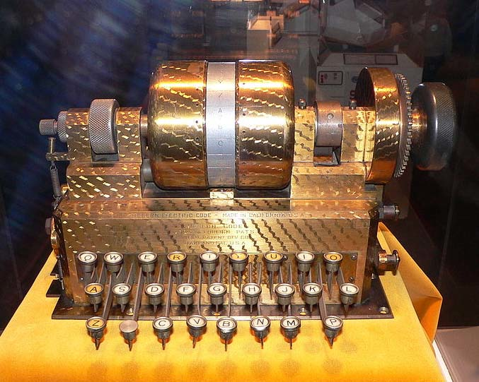
3. Rotor Machines (1870-1943)
Early example: the Hebern machine (single rotor)
Key: substitution table, stored in the initial settings of the motors.
A
B
C
.
.
X
Y
Z
K
S
T
.
.
R
N
E
E
K
S
T
.
.
R
N
N
E
K
S
T
.
.
R
key

Slide 51
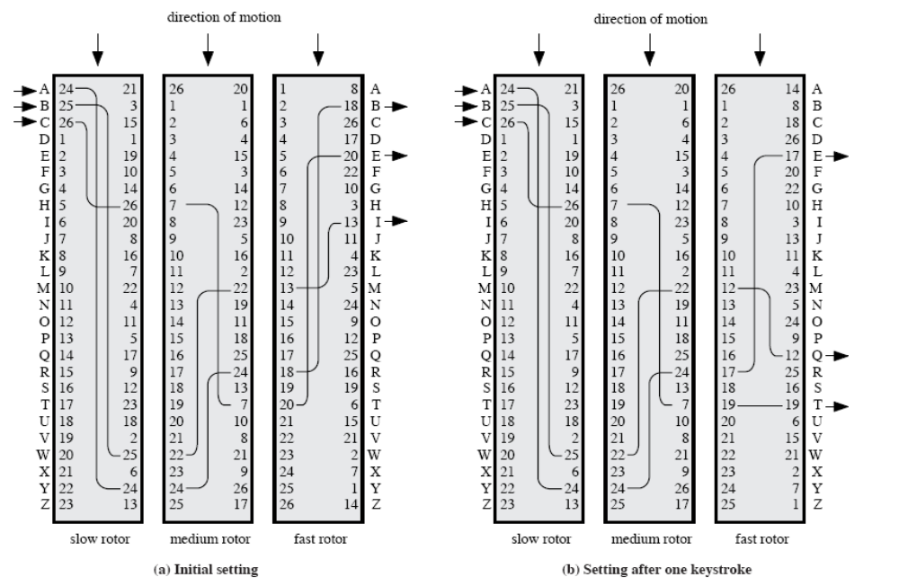
Rotor Machines
CEG 260, Meilin Liu
Notes:
Zili Shao

Slide 52
Steganography
An alternative to encryption
hides existence of message in a long message
  using only a subset of letters/words in a longer message marked in some way
  using invisible ink
  hiding in LSB in graphic image or sound file
has drawbacks
  high overhead to hide relatively few info bits
CEG 260, Meilin Liu
Notes:
Zili Shao

Slide 53
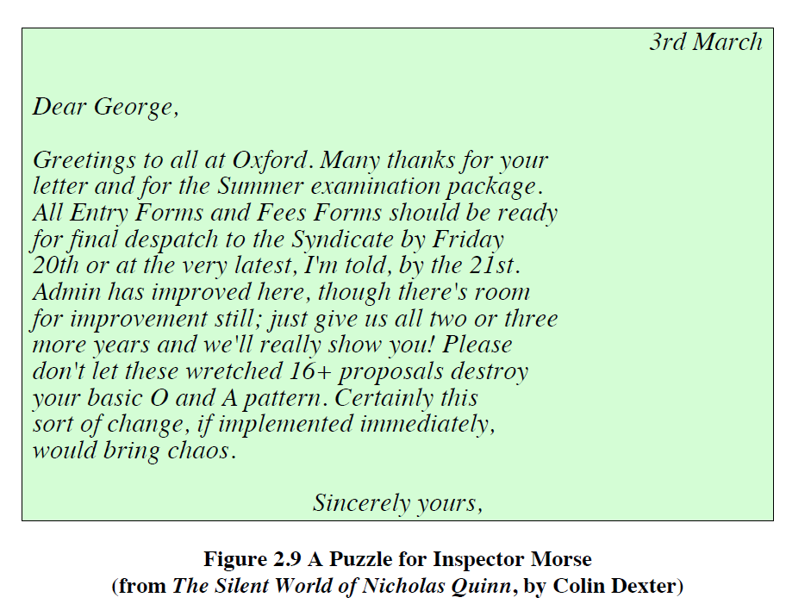
Steganography
CEG 260, Meilin Liu
Notes:
Zili Shao

